Slide 1
Algorithm Analysis and Design Divide and Conquer strategy (Matrix Multiplication by Strassen’s Algorithm)
Lecture -16

Slide 2
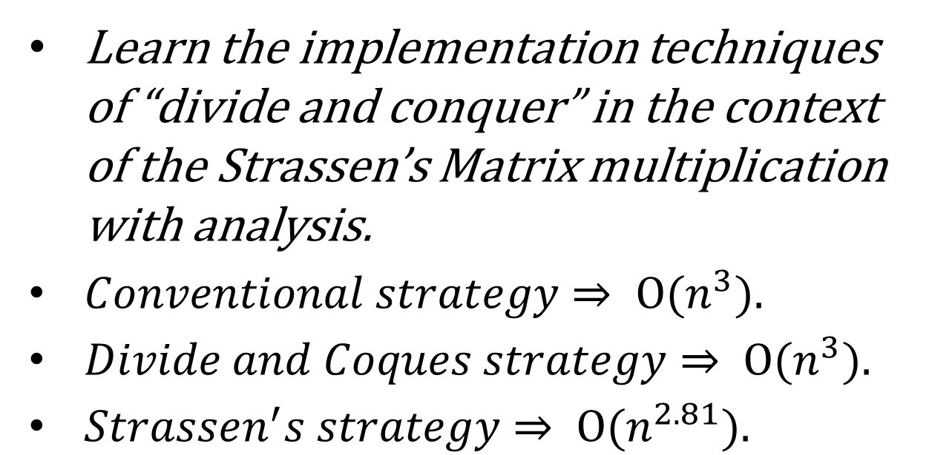
Overview
Learn the implementation techniques of “divide and conquer” in the context of the Strassen’s Matrix multiplication with analysis.
$Conventional strategy⇒ Ο(n^{3}).$
$Divide and Coques strategy⇒ Ο(n^{3}).$
$Strassen^{′}s strategy⇒ Ο(n^{2.81}).$

Slide 3
Matrix Multiplication
Problem definition:

Slide 4
Matrix Multiplication
Conventional strategy:

Slide 5
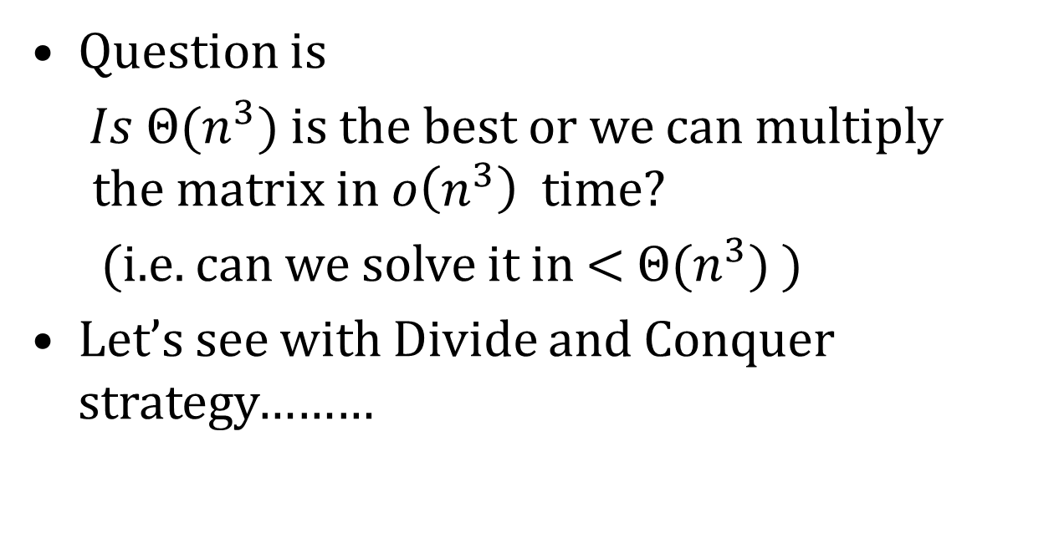
Matrix Multiplication
Question is
$Is Θ(n^{3})$ is the best or we can multiply the matrix in $ο\left(n^{3}\right)$ time?
(i.e. can we solve it in < $Θ(n^{3})$ )
Let’s see with Divide and Conquer strategy………

Slide 6
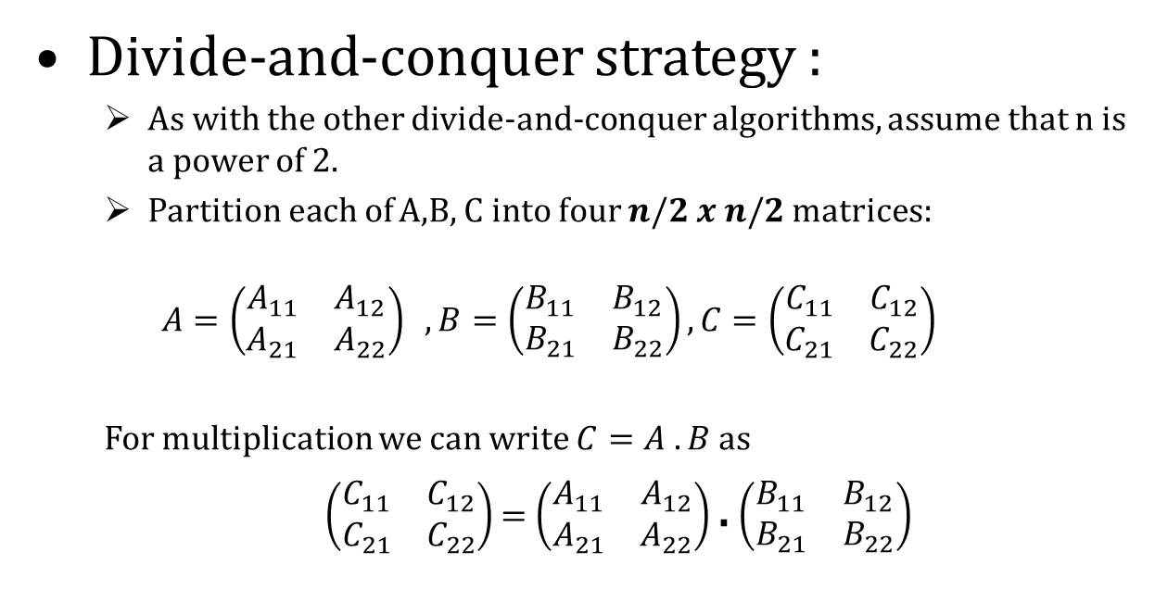
Matrix Multiplication
Divide-and-conquer strategy :
As with the other divide-and-conquer algorithms, assume that n is a power of 2.
Partition each of A,B, C into four $n/2 x n/2$matrices:
$$A=\left(\begin{matrix}A_{11} & A_{12} \\ A_{21} & A_{22}\end{matrix}\right) ,B=\left(\begin{matrix}B_{11} & B_{12} \\ B_{21} & B_{22}\end{matrix}\right), C=\left(\begin{matrix}C_{11} & C_{12} \\ C_{21} & C_{22}\end{matrix}\right)$$
For multiplication we can write $C=A . B$ as
$\left(\begin{matrix}C_{11} & C_{12} \\ C_{21} & C_{22}\end{matrix}\right)$ = $\left(\begin{matrix}A_{11} & A_{12} \\ A_{21} & A_{22}\end{matrix}\right)$ . $\left(\begin{matrix}B_{11} & B_{12} \\ B_{21} & B_{22}\end{matrix}\right)$

Slide 7
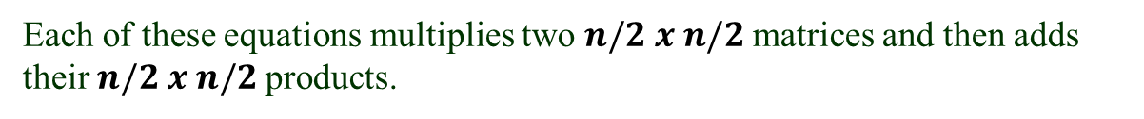
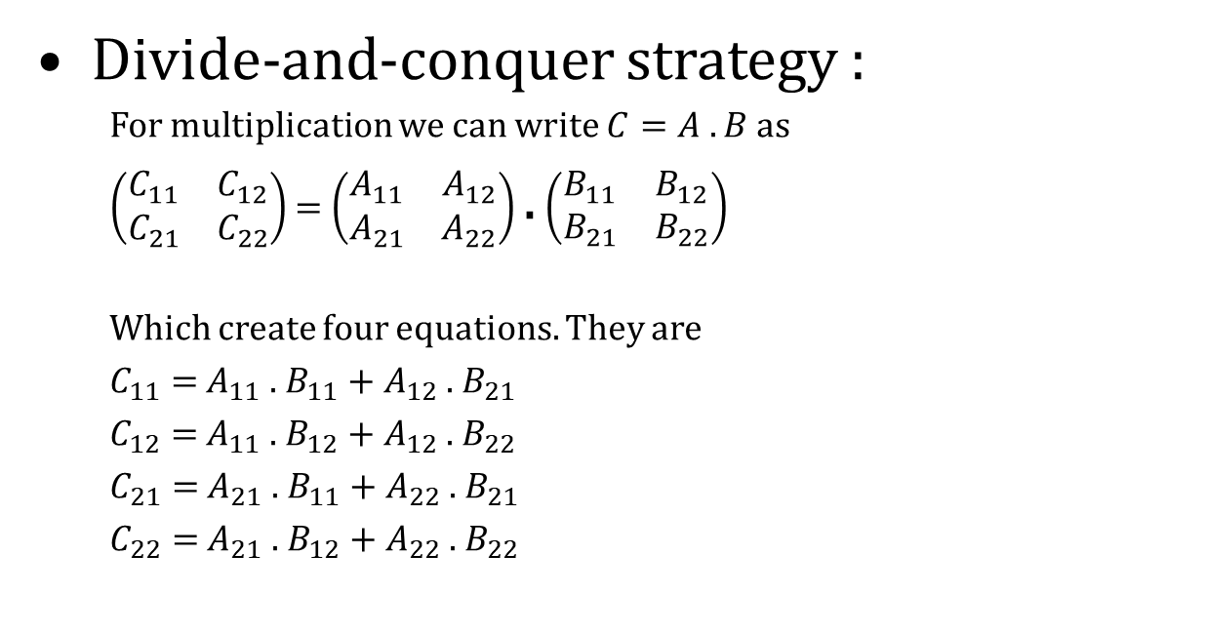
Matrix Multiplication
Divide-and-conquer strategy :
For multiplication we can write $C=A . B$ as
$\left(\begin{matrix}C_{11} & C_{12} \\ C_{21} & C_{22}\end{matrix}\right)$ = $\left(\begin{matrix}A_{11} & A_{12} \\ A_{21} & A_{22}\end{matrix}\right)$ . $\left(\begin{matrix}B_{11} & B_{12} \\ B_{21} & B_{22}\end{matrix}\right)$
Which create four equations. They are
$C_{11}=$ $A_{11}$ . $B_{11}$ + $A_{12}$ . $B_{21}$
$C_{12}=$ $A_{11}$ . $B_{12}$ + $A_{12}$ . $B_{22}$
$C_{21}=$ $A_{21}$ . $B_{11}$ + $A_{22}$ . $B_{21}$
$C_{22}=$ $A_{21}$ . $B_{12}$ + $A_{22}$ . $B_{22}$
Each of these equations multiplies two $n/2 x n/2$matrices and then adds their $n/2 x n/2$products.

Slide 8
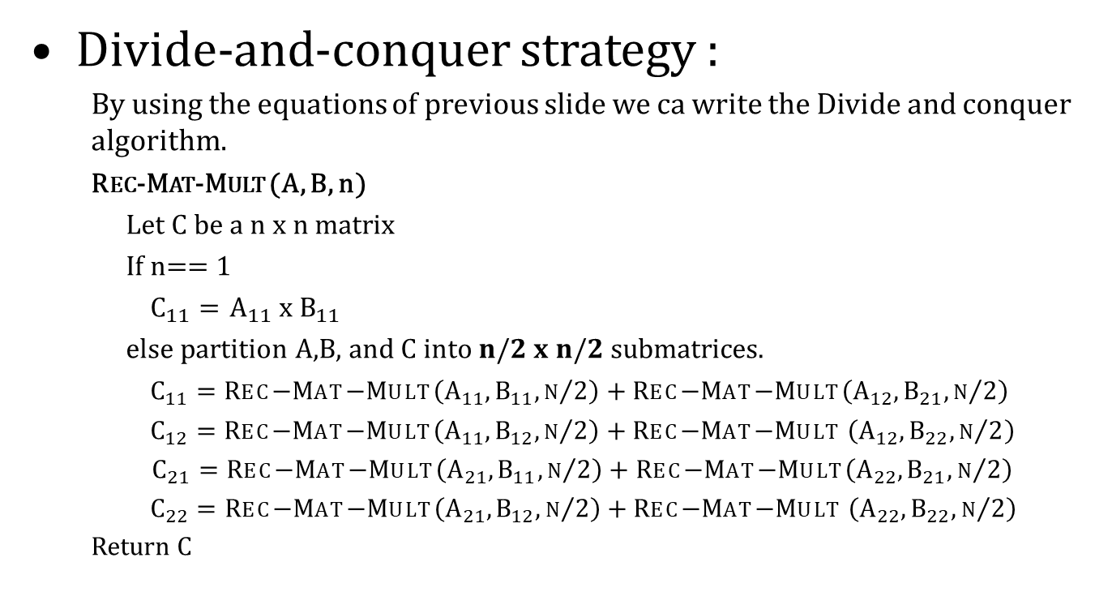
Matrix Multiplication
Divide-and-conquer strategy :
By using the equations of previous slide we ca write the Divide and conquer algorithm.
Rec-Mat-Mult (A, B, n)
Let C be a n x n matrix
If n== 1
$C_{11}=$ $A_{11}$ x $B_{11}$
else partition A,B, and C into $n/2 x n/2$submatrices.
$C_{11}=\text{R}\text{ec}\text{−}\text{M}\text{at}\text{−}\text{M}\text{ult}\left(A_{11},B_{11},n/2\right)+\text{R}\text{ec}\text{−}\text{M}\text{at}\text{−}\text{M}\text{ult}\left(A_{12},B_{21},n/2\right)$
$C_{12}=\text{R}\text{ec}\text{−}\text{M}\text{at}\text{−}\text{M}\text{ult}\left(A_{11},B_{12},n/2\right)+$ $\text{R}\text{ec}\text{−}\text{M}\text{at}\text{−}\text{M}\text{ult} \left(A_{12},B_{22},n/2\right)$
$C_{21}=\text{R}\text{ec}\text{−}\text{M}\text{at}\text{−}\text{M}\text{ult}\left(A_{21},B_{11},n/2\right)+\text{R}\text{ec}\text{−}\text{M}\text{at}\text{−}\text{M}\text{ult}\left(A_{22},B_{21},n/2\right)$
$C_{22}=\text{R}\text{ec}\text{−}\text{M}\text{at}\text{−}\text{M}\text{ult}\left(A_{21},B_{12},n/2\right)+$ $\text{R}\text{ec}\text{−}\text{M}\text{at}\text{−}\text{M}\text{ult} \left(A_{22},B_{22},n/2\right)$
Return C

Slide 9
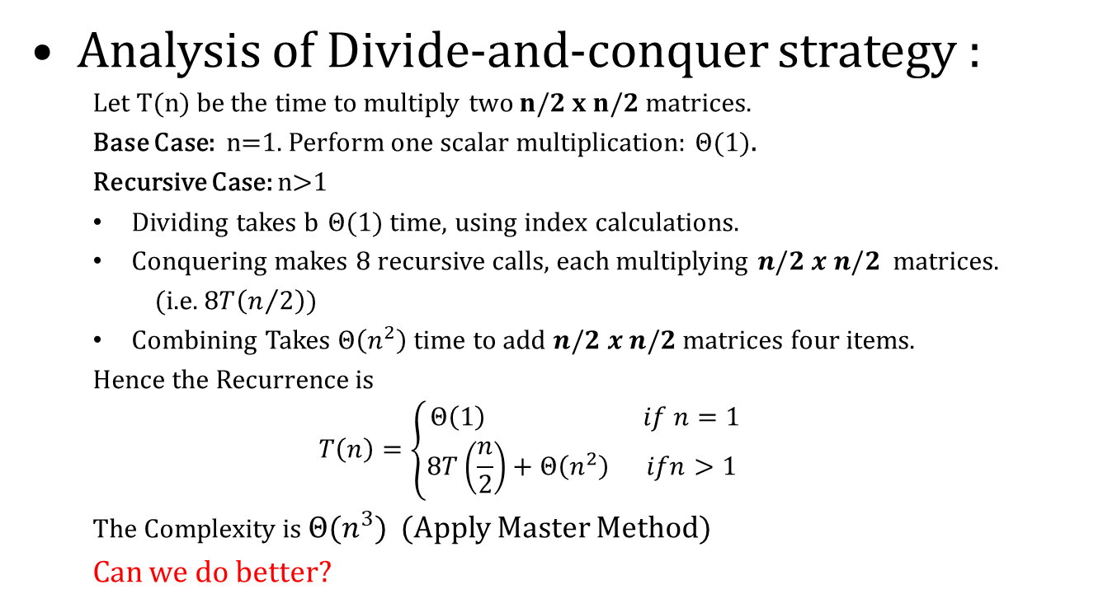
Matrix Multiplication
Analysis of Divide-and-conquer strategy :
Let T(n) be the time to multiply two $n/2 x n/2$matrices.
Base Case: n=1. Perform one scalar multiplication: $Θ(1)$.
Recursive Case: n>1
Dividing takes b $Θ(1)$ time, using index calculations.
Conquering makes 8 recursive calls, each multiplying $n/2 x n/2$ matrices.
(i.e. $8T\left(n/2\right))$
Combining Takes $Θ\left(n^{2}\right)$ time to add $n/2 x n/2$matrices four items.
Hence the Recurrence is
$$T\left(n\right)=\left\{\begin{matrix}Θ\left(1\right) & if n=1 \\ 8T\left(\frac{n}{2}\right)+Θ\left(n^{2}\right) & ifn>1\end{matrix}\right.$$
The Complexity is $Θ(n^{3})$ (Apply Master Method)
Can we do better?

Slide 10
Matrix Multiplication
Strassen’s strategy :
The Idea:
Make the recursion tree less bushy.
Perform only 7(seven) recursive multiplications of n/2 x n/2 matrices, rather than 8(Eight).

Slide 11
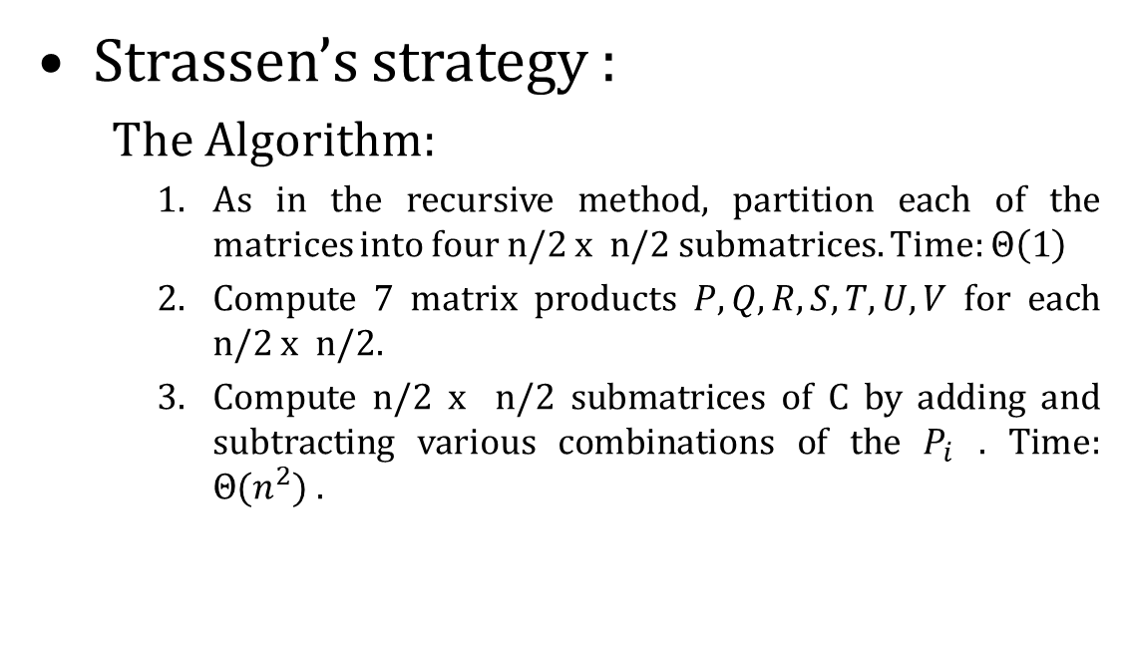
Matrix Multiplication
Strassen’s strategy :
The Algorithm:
As in the recursive method, partition each of the matrices into four n/2 x n/2 submatrices. Time: $Θ\left(1\right)$
Compute 7 matrix products $P,Q,R,S,T,U,V$ for each n/2 x n/2.
Compute n/2 x n/2 submatrices of C by adding and subtracting various combinations of the $P_{i}$ . Time: $Θ$($n^{2}$) .

Slide 12
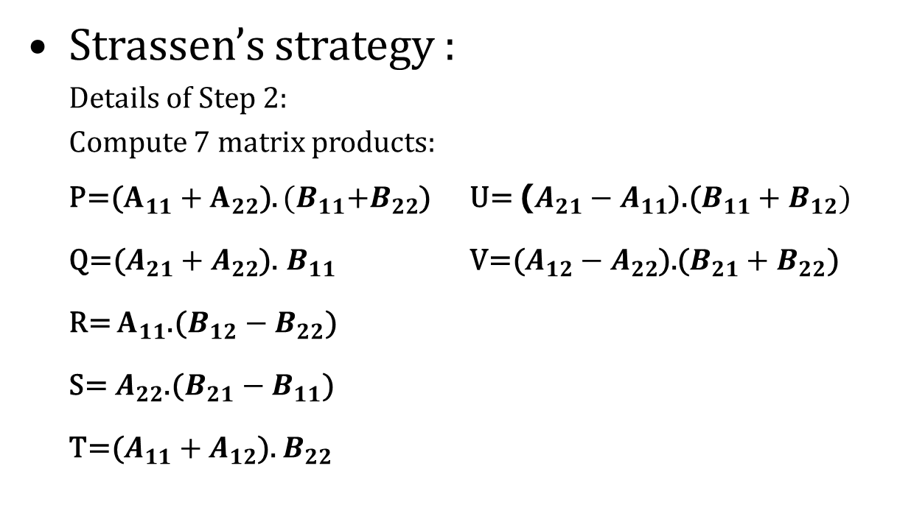
Matrix Multiplication
Strassen’s strategy :
Details of Step 2:
Compute 7 matrix products:
P=($A_{11}+A_{22}$). ${(B}_{11}+B_{22}$) U= ($A_{21}−A_{11}$).($B_{11}+B_{12})$
Q=($A_{21}+A_{22}$). $B_{11}$ V=($A_{12}−A_{22}$).($B_{21}+B_{22}$)
R= $A_{11}$.($B_{12}−B_{22}$)
S= $A_{22}$.($B_{21}−B_{11}$)
T=($A_{11}+A_{12}$). $B_{22}$

Slide 13
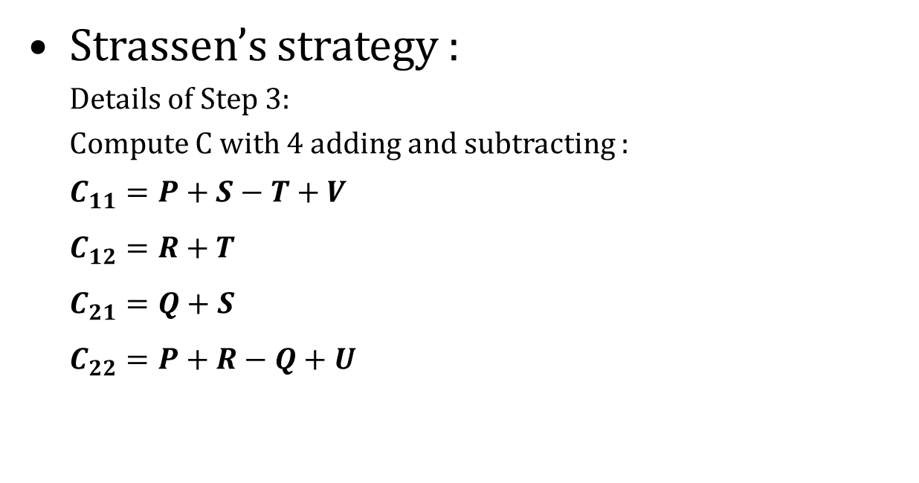
Matrix Multiplication
Strassen’s strategy :
Details of Step 3:
Compute C with 4 adding and subtracting :
$$C_{11}=P+S−T+V$$
$$C_{12}=R+T$$
$$C_{21}=Q+S$$
$$C_{22}=P+R−Q+U$$

Slide 14
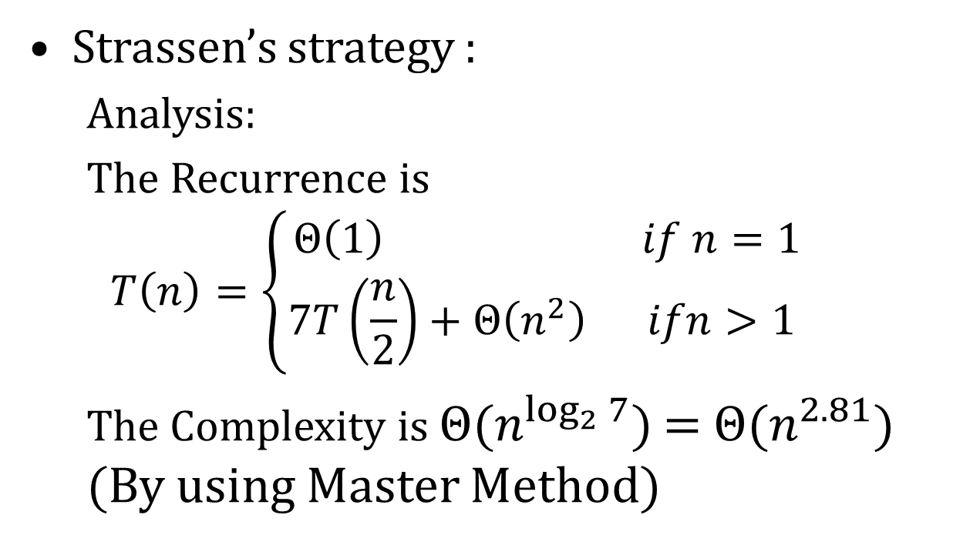
Matrix Multiplication
Strassen’s strategy :
Analysis:
The Recurrence is
$$T\left(n\right)=\left\{\begin{matrix}Θ\left(1\right) & if n=1 \\ 7T\left(\frac{n}{2}\right)+Θ\left(n^{2}\right) & ifn>1\end{matrix}\right.$$
The Complexity is $Θ(n^{\log_{2}{7}})$ = $Θ(n^{2.81})$ (By using Master Method)

Slide 15
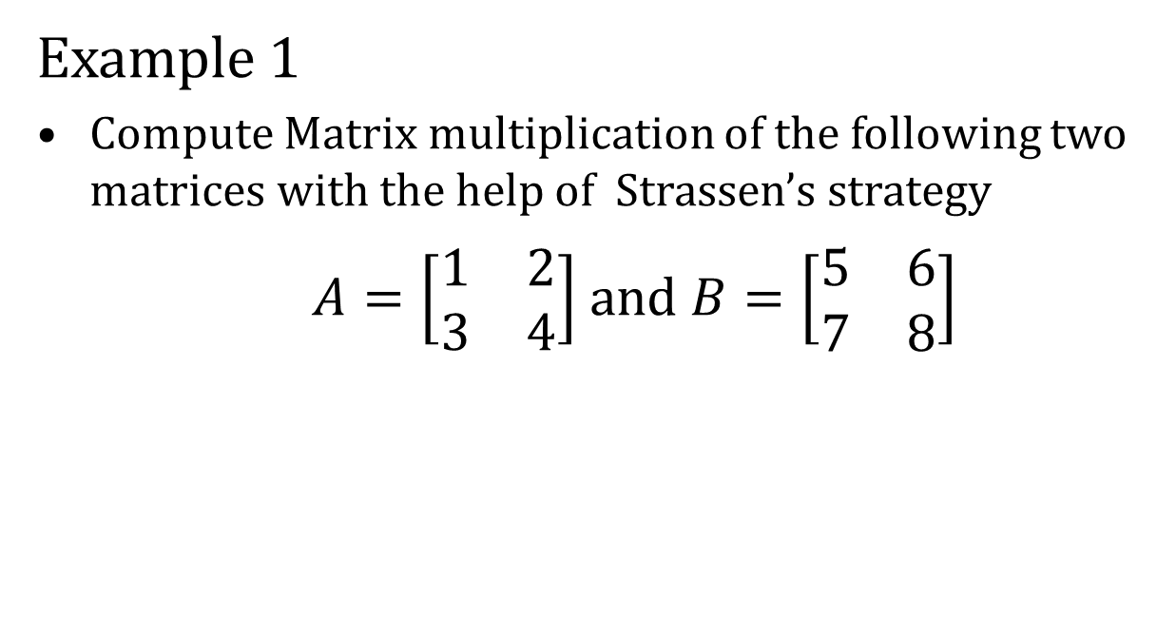
Matrix Multiplication
Example 1
Compute Matrix multiplication of the following two matrices with the help of Strassen’s strategy
$A=\left[\begin{matrix}1 & 2 \\ 3 & 4\end{matrix}\right]$ and $B=\left[\begin{matrix}5 & 6 \\ 7 & 8\end{matrix}\right]$

Slide 16
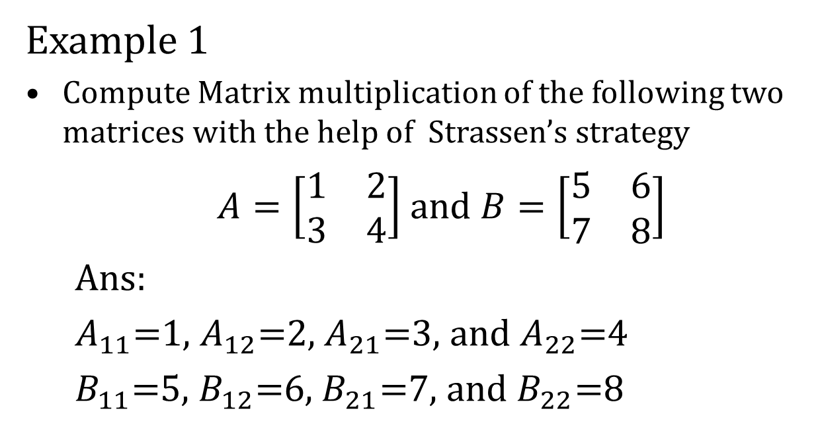
Matrix Multiplication
Example 1
Compute Matrix multiplication of the following two matrices with the help of Strassen’s strategy
$A=\left[\begin{matrix}1 & 2 \\ 3 & 4\end{matrix}\right]$ and $B=\left[\begin{matrix}5 & 6 \\ 7 & 8\end{matrix}\right]$
Ans:
$A_{11}$=1, $A_{12}$=2, $A_{21}$=3, and $A_{22}$=4
$B_{11}$=5, $B_{12}$=6, $B_{21}$=7, and $B_{22}$=8

Slide 17
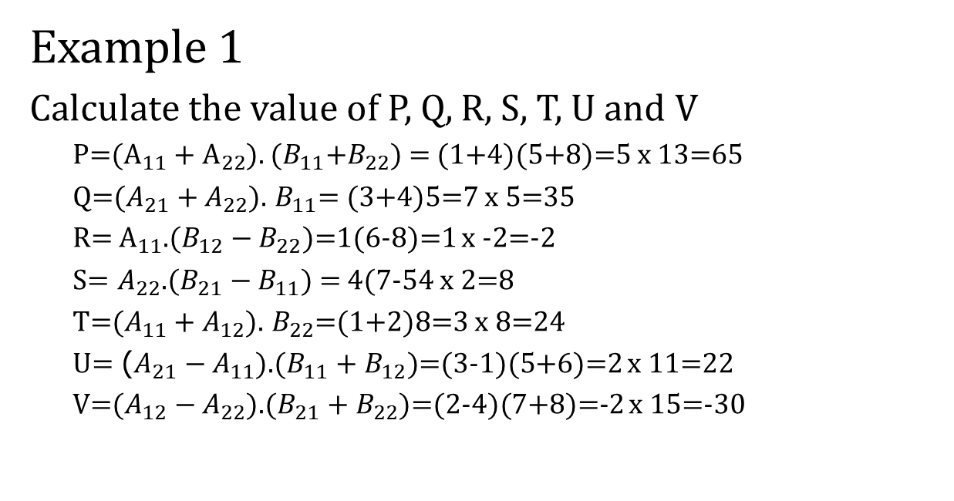
Matrix Multiplication
Example 1
Calculate the value of P, Q, R, S, T, U and V
P=($A_{11}+A_{22}$). ${(B}_{11}+B_{22}$) = (1+4)(5+8)=5 x 13=65
Q=($A_{21}+A_{22}$). $B_{11}$= (3+4)5=7 x 5=35
R= $A_{11}$.($B_{12}−B_{22}$)=1(6-8)=1 x -2=-2
S= $A_{22}$.($B_{21}−B_{11}$) = 4(7-54 x 2=8
T=($A_{11}+A_{12}$). $B_{22}$=(1+2)8=3 x 8=24
U= ($A_{21}−A_{11}$).($B_{11}+B_{12})$=(3-1)(5+6)=2 x 11=22
V=($A_{12}−A_{22}$).($B_{21}+B_{22}$)=(2-4)(7+8)=-2 x 15=-30

Slide 18
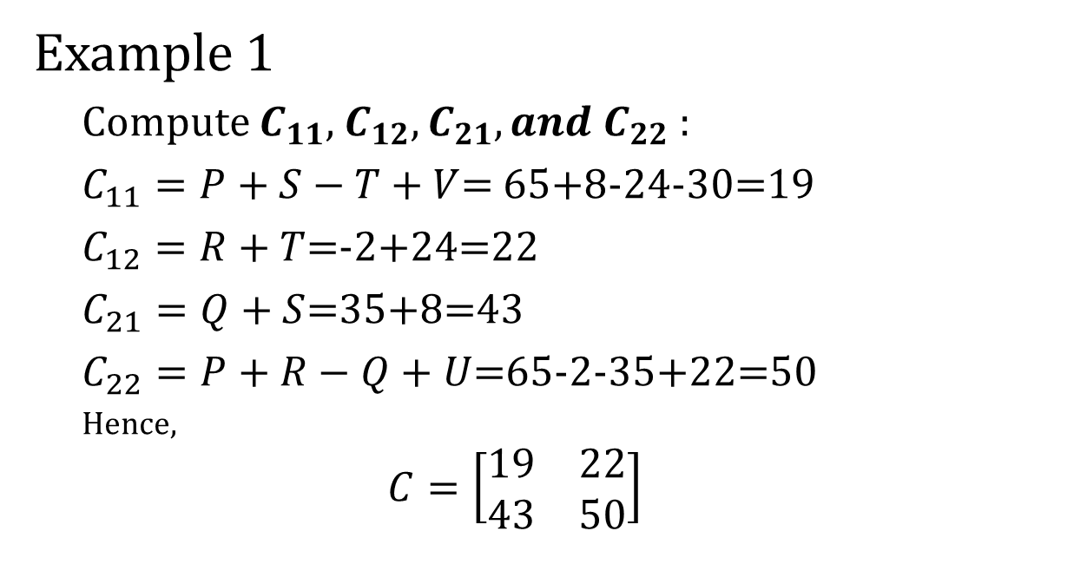
Matrix Multiplication
Example 1
Compute $C_{11}$, $C_{12},C_{21}, and C_{22}$ :
$C_{11}=P+S−T+V$= 65+8-24-30=19
$C_{12}=R+T$=-2+24=22
$C_{21}=Q+S$=35+8=43
$C_{22}=P+R−Q+U$=65-2-35+22=50
Hence,
$$C=\left[\begin{matrix}19 & 22 \\ 43 & 50\end{matrix}\right]$$

Slide 19
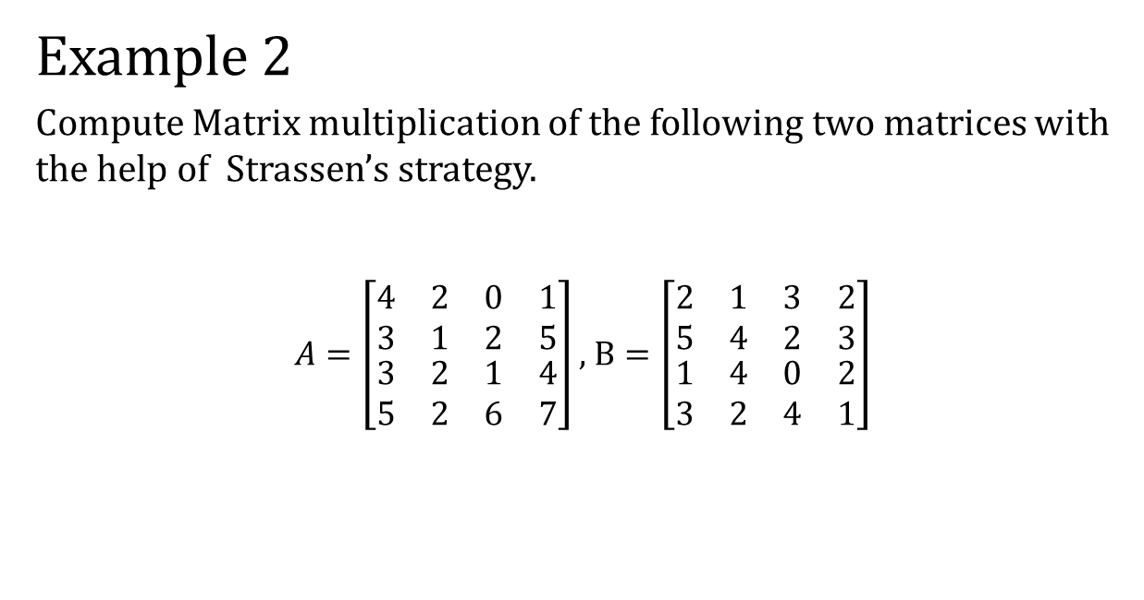
Matrix Multiplication
Example 2
Compute Matrix multiplication of the following two matrices with the help of Strassen’s strategy.
$A=\left[\begin{matrix}\begin{matrix}4 & 2 \\ 3 & 1\end{matrix} & \begin{matrix}0 & 1 \\ 2 & 5\end{matrix} \\ \begin{matrix}3 & 2 \\ 5 & 2\end{matrix} & \begin{matrix}1 & 4 \\ 6 & 7\end{matrix}\end{matrix}\right]$ , $B=\left[\begin{matrix}\begin{matrix}2 & 1 \\ 5 & 4\end{matrix} & \begin{matrix}3 & 2 \\ 2 & 3\end{matrix} \\ \begin{matrix}1 & 4 \\ 3 & 2\end{matrix} & \begin{matrix}0 & 2 \\ 4 & 1\end{matrix}\end{matrix}\right]$

Slide 20
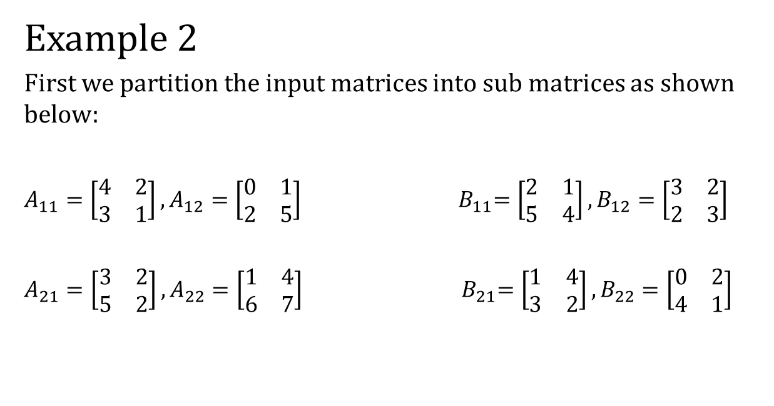
Matrix Multiplication
Example 2
First we partition the input matrices into sub matrices as shown below:
$A_{11}=\left[\begin{matrix}4 & 2 \\ 3 & 1\end{matrix}\right],A_{12}=\left[\begin{matrix}0 & 1 \\ 2 & 5\end{matrix}\right]$ ${ B}_{11}=\left[\begin{matrix}2 & 1 \\ 5 & 4\end{matrix}\right],B_{12}=\left[\begin{matrix}3 & 2 \\ 2 & 3\end{matrix}\right]$
$A_{21}=\left[\begin{matrix}3 & 2 \\ 5 & 2\end{matrix}\right],A_{22}=\left[\begin{matrix}1 & 4 \\ 6 & 7\end{matrix}\right]$ ${ B}_{21}=\left[\begin{matrix}1 & 4 \\ 3 & 2\end{matrix}\right],B_{22}=\left[\begin{matrix}0 & 2 \\ 4 & 1\end{matrix}\right]$

Slide 21
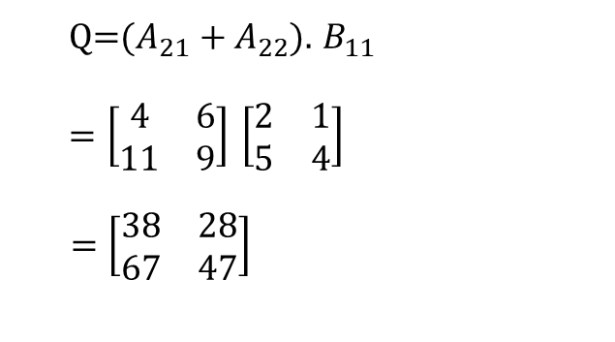
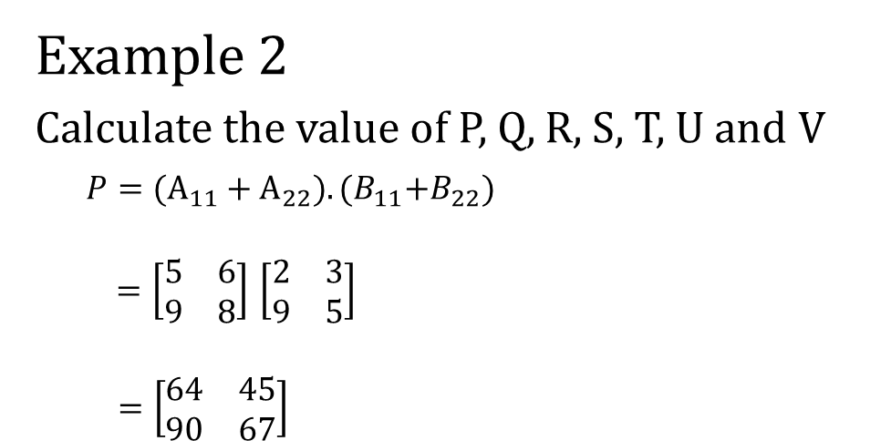
Matrix Multiplication
Example 2
Calculate the value of P, Q, R, S, T, U and V
$$P=(A_{11}+A_{22}). {(B}_{11}+B_{22})$$
$=\left[\begin{matrix}5 & 6 \\ 9 & 8\end{matrix}\right]$ $\left[\begin{matrix}2 & 3 \\ 9 & 5\end{matrix}\right]$
$=\left[\begin{matrix}64 & 45 \\ 90 & 67\end{matrix}\right]$
Q=($A_{21}+A_{22}$). $B_{11}$
$=\left[\begin{matrix}4 & 6 \\ 11 & 9\end{matrix}\right]$ $\left[\begin{matrix}2 & 1 \\ 5 & 4\end{matrix}\right]$
$$=\left[\begin{matrix}38 & 28 \\ 67 & 47\end{matrix}\right]$$

Slide 22
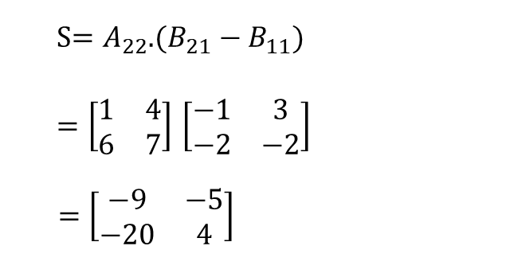

Matrix Multiplication
Example 2
R= $A_{11}$.($B_{12}−B_{22}$)
$=\left[\begin{matrix}4 & 2 \\ 3 & 1\end{matrix}\right]$ $\left[\begin{matrix}3 & 0 \\ −2 & 2\end{matrix}\right]$
$$=\left[\begin{matrix}8 & 4 \\ 7 & 2\end{matrix}\right]$$
S= $A_{22}$.($B_{21}−B_{11}$)
$=\left[\begin{matrix}1 & 4 \\ 6 & 7\end{matrix}\right]$ $\left[\begin{matrix}−1 & 3 \\ −2 & −2\end{matrix}\right]$
$$=\left[\begin{matrix}−9 & −5 \\ −20 & 4\end{matrix}\right]$$

Slide 23
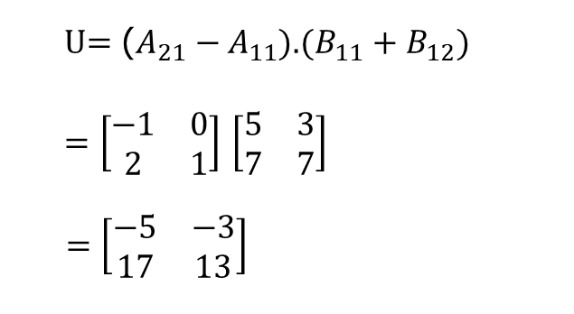

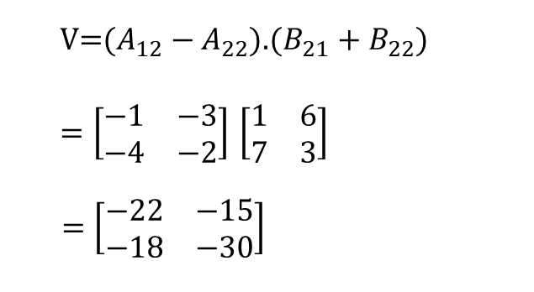
Matrix Multiplication
Example 2
T=($A_{11}+A_{12}$). $B_{22}$
$=\left[\begin{matrix}4 & 3 \\ 5 & 6\end{matrix}\right]$ $\left[\begin{matrix}0 & 2 \\ 4 & 1\end{matrix}\right]$
$$=\left[\begin{matrix}12 & 11 \\ 24 & 16\end{matrix}\right]$$
U= ($A_{21}−A_{11}$).($B_{11}+B_{12})$
$=\left[\begin{matrix}−1 & 0 \\ 2 & 1\end{matrix}\right]$ $\left[\begin{matrix}5 & 3 \\ 7 & 7\end{matrix}\right]$
$$=\left[\begin{matrix}−5 & −3 \\ 17 & 13\end{matrix}\right]$$
V=($A_{12}−A_{22}$).($B_{21}+B_{22}$)
$=\left[\begin{matrix}−1 & −3 \\ −4 & −2\end{matrix}\right]$ $\left[\begin{matrix}1 & 6 \\ 7 & 3\end{matrix}\right]$
$$=\left[\begin{matrix}−22 & −15 \\ −18 & −30\end{matrix}\right]$$

Slide 24
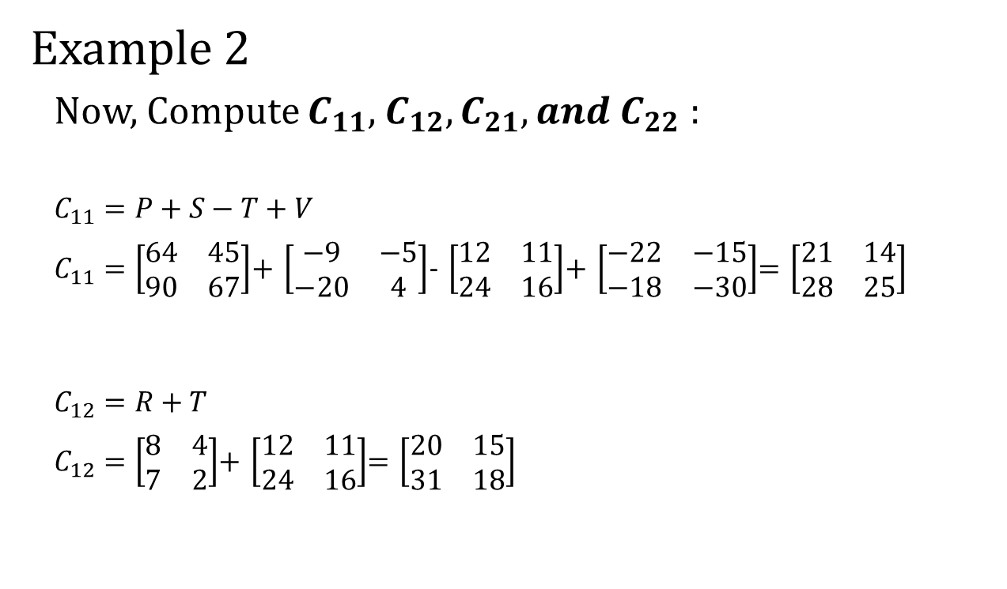
Matrix Multiplication
Example 2
Now, Compute $C_{11}$, $C_{12},C_{21}, and C_{22}$ :
$$C_{11}=P+S−T+V$$
$C_{11}=\left[\begin{matrix}64 & 45 \\ 90 & 67\end{matrix}\right]$+ $\left[\begin{matrix}−9 & −5 \\ −20 & 4\end{matrix}\right]$- $\left[\begin{matrix}12 & 11 \\ 24 & 16\end{matrix}\right]$+ $\left[\begin{matrix}−22 & −15 \\ −18 & −30\end{matrix}\right]$= $\left[\begin{matrix}21 & 14 \\ 28 & 25\end{matrix}\right]$
$$C_{12}=R+T$$
$C_{12}=\left[\begin{matrix}8 & 4 \\ 7 & 2\end{matrix}\right]$+ $\left[\begin{matrix}12 & 11 \\ 24 & 16\end{matrix}\right]$= $\left[\begin{matrix}20 & 15 \\ 31 & 18\end{matrix}\right]$

Slide 25
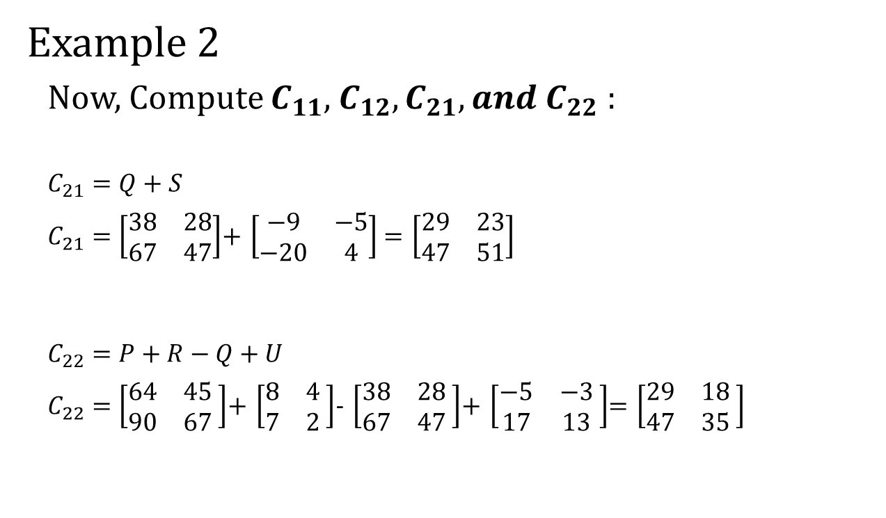
Matrix Multiplication
Example 2
Now, Compute $C_{11}$, $C_{12},C_{21}, and C_{22}$ :
$$C_{21}=Q+S$$
$C_{21}=\left[\begin{matrix}38 & 28 \\ 67 & 47\end{matrix}\right]$+ $\left[\begin{matrix}−9 & −5 \\ −20 & 4\end{matrix}\right]$ = $\left[\begin{matrix}29 & 23 \\ 47 & 51\end{matrix}\right]$
$$C_{22}=P+R−Q+U$$
$C_{22}=\left[\begin{matrix}64 & 45 \\ 90 & 67\end{matrix} \right]$+ $\left[\begin{matrix}8 & 4 \\ 7 & 2\end{matrix} \right]$- $\left[\begin{matrix}38 & 28 \\ 67 & 47\end{matrix} \right]$+ $\left[\begin{matrix}−5 & −3 \\ 17 & 13\end{matrix} \right]$= $\left[\begin{matrix}29 & 18 \\ 47 & 35\end{matrix} \right]$

Slide 26
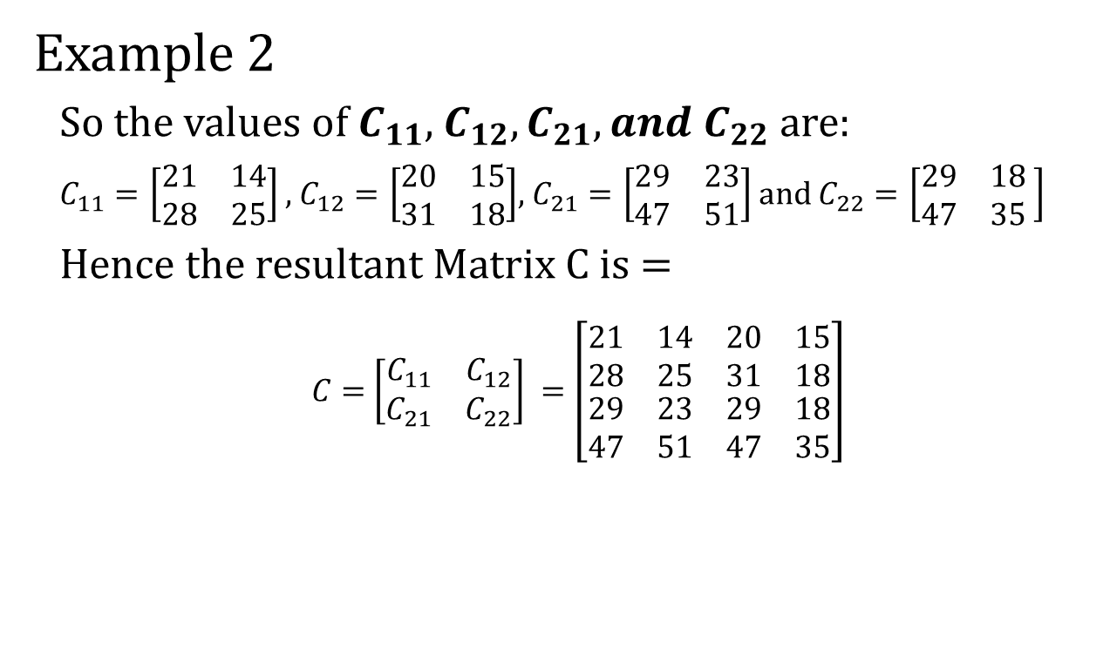
Matrix Multiplication
Example 2
So the values of $C_{11}$, $C_{12},C_{21}, and C_{22}$ are:
$C_{11}=$ $\left[\begin{matrix}21 & 14 \\ 28 & 25\end{matrix}\right]$ , $C_{12}=$ $\left[\begin{matrix}20 & 15 \\ 31 & 18\end{matrix}\right]$, $C_{21}=$ $\left[\begin{matrix}29 & 23 \\ 47 & 51\end{matrix}\right]$ and $C_{22}=$ $\left[\begin{matrix}29 & 18 \\ 47 & 35\end{matrix} \right]$
Hence the resultant Matrix C is =
$C=$ $\left[\begin{matrix}C_{11} & C_{12} \\ C_{21} & C_{22}\end{matrix}\right] =\left[\begin{matrix}\begin{matrix}21 & 14 \\ 28 & 25\end{matrix} & \begin{matrix}20 & 15 \\ 31 & 18\end{matrix} \\ \begin{matrix}29 & 23 \\ 47 & 51\end{matrix} & \begin{matrix}29 & 18 \\ 47 & 35\end{matrix}\end{matrix}\right]$

Slide 27
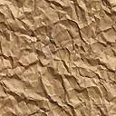
Thank U

